Slide 1

Capstone Project
Analytical CRM Development for the Bank
By Sai Sweatha

Slide 2

AGENDA
Average No. of Products: 1.53
1
COMPARISON RELATIONS AND IMPACTS
2
ANALYSIS
3
DASHBOARDS
4
INTERPRETATIONS
5
CONCLUSION

Slide 3
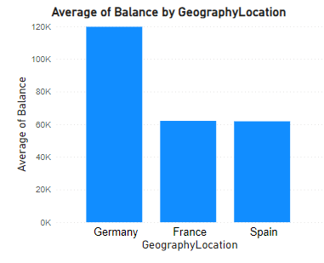


ACCOUNT BALANCES ACROSS DIFFERENT REGIONS
Germany has the highest average customer account balance, amounting to 119730.11.

Slide 4
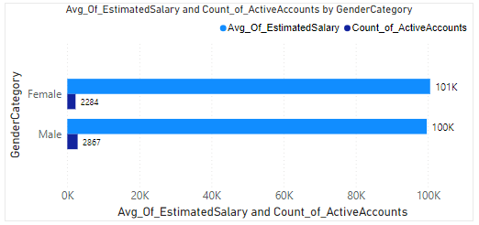
The data shows males have more active accounts compared to females. But still, for females is higher than that of males, which indicates that gender affects the
Relationship Between Gender, Estimated Salary, and Active Accounts
Males have more active accounts compared to females. But still,
the AvgEstimatedSalary for females is higher than that of males,
which indicates that gender affects the AvgEstimatedSalary

Slide 5

Average Credit Score of Exiting vs. Retained Customers
The difference in average credit scores between the two groups is relatively small, it appears that customers who remain have a slightly higher average credit score compared to those who have exited.
ExitCategory
AvgCreditScore
Exit
645.35
Retain
651.85

Slide 6
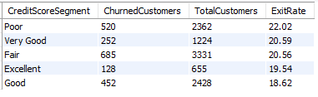
Customer Segmentation by Credit Score and Highest Exit Rate Segment
The data suggests that customers in the "Poor" credit score segment have the highest exit rate at 22.02%. (The number of exited customer is maximum for Fair segment but it has high total customers count.)

Slide 7

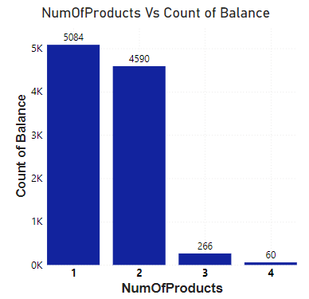
Relationship Between Number of Products and Account Balance for Exiting Customers
Based on the analysis, it shows that the majority of customer who purchased 1 or 2 products exit more i.e., 5086 and 4590 for 1 and 2 products respectively. In the above chart, a filter ExitID = 1 is used.

Slide 8
Average Tenure of Exiting Customers by Age Bracket
Overall, there isn't a significant difference in the average tenure among the different age brackets of exiting customers. However, it's noteworthy that customers aged between 31 and 50 have the highest average tenure
Age Bracket
AvgTenure
31-50
4.87
18-30
4.84
50+
4.85

Slide 9

Impact of Credit Card Ownership on Customer Churn
In this case, both credit card holders and non-credit card holders exhibit relatively similar churn rates, with credit card holders at 20.18% and non-credit card holders at 20.81%. This suggests that, based on the available data, there is no substantial difference in churn rates between customers who hold credit cards and those who do not.

Slide 10
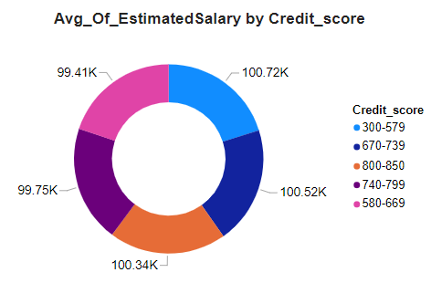
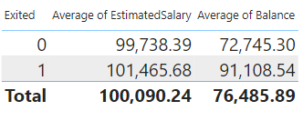
Relation between Salaries
From the table it is evident that there is no relation between the Credit Score of the customer and the Average of Estimated Salary. As the data suggests, the lowest Credit score has the highest Average Estimated Salary.
On average, customers who have exited the bank have a slightly higher estimated salary compared to those who have remained. Customers who have exited the bank have a notably higher average balance compared to those who have remained. This suggests that customers with higher balances are more likely to leave the bank.

Slide 11
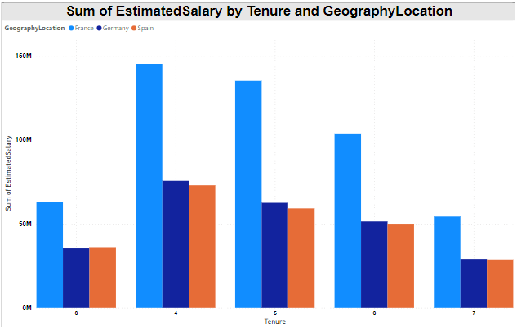
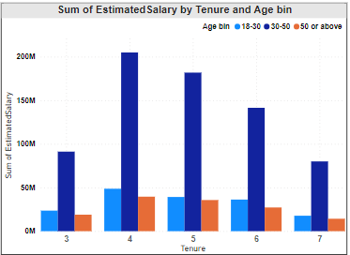
Customer Tenure Value Forecast
There are noticeable differences in the sum of estimated salaries across France, Germany, and Spain. France and Germany generally have higher total estimated salaries compared to Spain, indicating potential economic disparities between these regions.
While France and Germany have higher total estimated salaries, the tenure patterns vary across different geographic locations. France and Germany show a similar trend of increasing estimated salaries up to a certain tenure (around 5 years) before declining for longer tenures. In contrast, Spain exhibits a similar trend but with lower estimated salaries overall.
The analysis of tenure distribution suggests that customers in France and Germany tend to have longer relationships with the bank, as indicated by their tenure extending up to 7 years. This may imply higher customer loyalty or satisfaction levels in these regions compared to Spain.

Slide 12
ANALYSIS

Slide 13
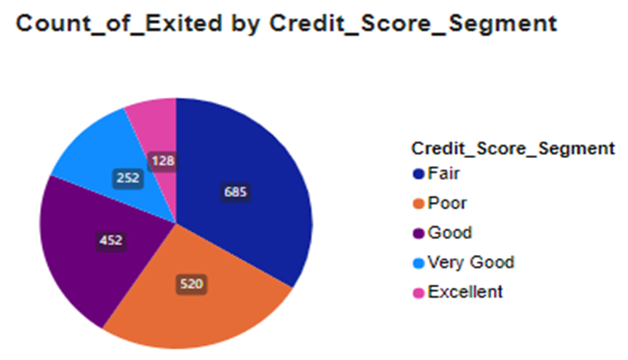
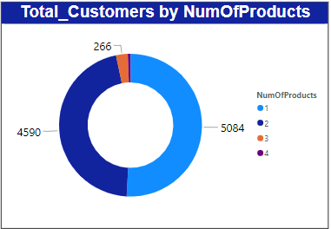
Marketing Campaign Effectiveness
Product Affinity Study
Credit score segment of Excellent and Very good has the least count of exited customers which shows that the improvement of credit score impacts in the retention rate of the customers.
By conducting Marketing Campaigns the Credit score of the customer will increase which will directly impact on the retention rates.
There are high numbers of customers with only one or two products. This suggests that there is a strong association between the number of products a customer holds and their possession with the bank.
Targeted marketing campaigns and personalized recommendations can be tailored based on customers' existing product holdings to encourage them to expand their relationships with the bank.

Slide 14
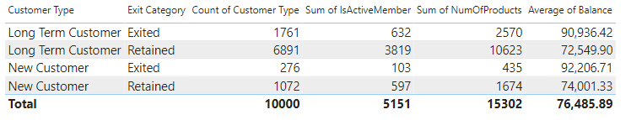
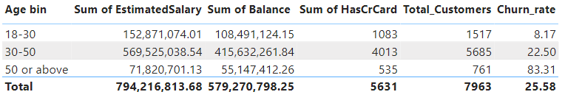
Customer Behavior Analysis
Customer Exit Reasons Exploration
Long term customers who have retained in the bank have purchased more number of products when compared to new customers.
It is to be noted that the Number of customers and their Activeness are more in this category.
The reason behind the Low average balance among other categories might be because they have purchased more products.
The churn rate is notably higher for customers aged 50 or above compared to other age groups. This indicates that older customers may be more likely to leave the bank.
Customers who exited the bank have a significant total balance and estimated salary compared to others. This suggests that financial factors may play a role in their decision to leave.

Slide 15

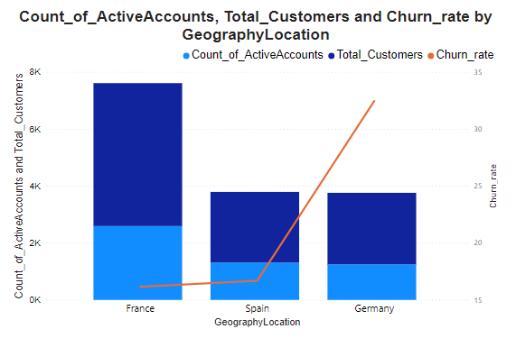
Geographic Market Trends
Germany has the highest churn rate at 32.44%, followed by Spain at 16.67%, and France at 16.15%. Churn rates vary across geographic regions, indicating potential differences in economic conditions, customer behavior, or competitive landscapes.
France and Spain have relatively similar counts of active accounts despite differences in churn rates.
In regions with high churn rates, bank may need to focus on improving customer retention strategies, such as enhancing customer service, offering competitive rates, or introducing loyalty programs.

Slide 16

Customer Segmentation by Credit Score
and Identification of High Exit Rate Segment
CreditScoreSegment | ExitedCustomers | TotalCustomers | ExitRate
Poor | 520 | 2362 | 22.02
Very Good | 252 | 1224 | 20.59
Fair | 685 | 3331 | 20.56
Excellent | 128 | 655 | 19.54
Good | 452 | 2428 | 18.62
The data suggests that customers in the "Poor" credit score segment have the highest exit rate at 22.02%. (The number of exited customer is maximum for Fair segment but it has high total customers count.)

Slide 17
DASHBOARDS

Slide 18
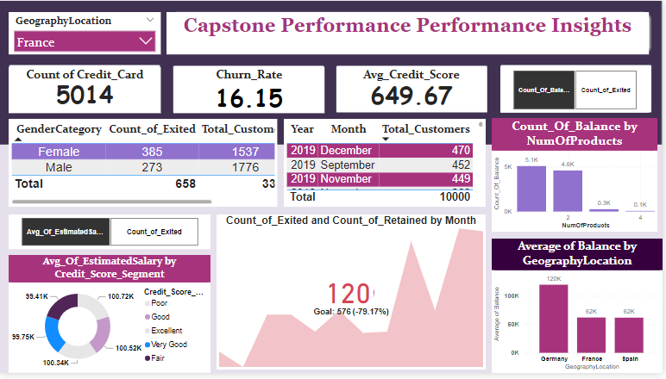

Slide 19
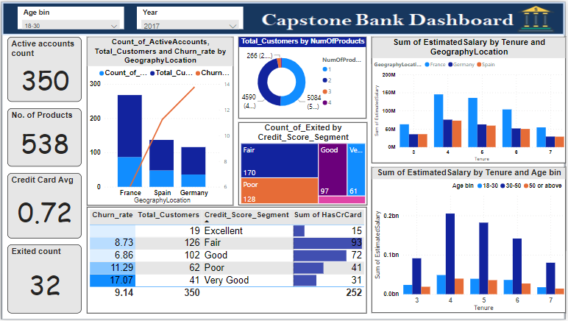

Slide 20
INTERPRETATIONS

Slide 21
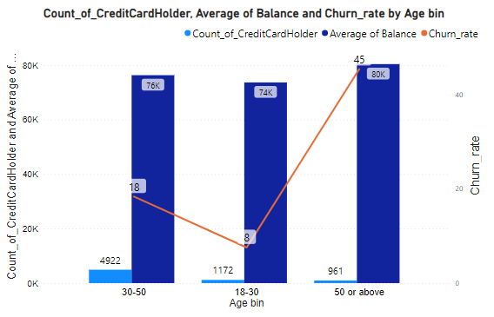
Risk Management Assessment
Customers aged 50 or above demonstrate a significantly higher churn rate compared to younger age groups, indicating that they pose a higher financial risk to the bank.
Despite having a higher average balance, older customers are more likely to churn, suggesting that factors beyond account balance influence their decision to leave the bank.
It suggests that older customers warrant special attention in risk management strategies to mitigate potential losses associated with churn.

Slide 22

Reasons for Leaving the Bank
Dissatisfaction with banking services or customer experiences.
Inadequate credit card benefits or rewards.
Financial instability or changes in personal circumstances.
Better offers or services from competitors.
Lack of tailored products or solutions for older customers.

Slide 23
CONCLUSION

Slide 24
1. Strategies to Decrease Churn Rate
The bank can conduct marketing and engagement campaigns tailored to the unique needs and preferences of different age groups, such as offering retirement planning services and personalized financial advice for older customers.
Specialized customer support services, including dedicated helplines for senior citizens or personalized assistance for complex financial transactions, can be provided to improve satisfaction and retention among older customers.
Conducting financial literacy workshops and educational seminars targeted at different age groups can empower customers with knowledge and skills to manage their finances effectively, reducing the likelihood of churn.

Slide 25
CONT.
Implementing loyalty programs and retention incentives customized for each age group, including rewards, discounts, and exclusive benefits, can enhance customer loyalty and decrease churn rates.
Establishing feedback mechanisms to gather insights directly from customers about their needs, preferences, and pain points can inform continuous refinement and optimization of retention strategies for each age group.

Slide 26
2. Enhance Customer Satisfaction
Conduct customer surveys, interviews, or feedback sessions to gain insights into what customers value most. Continuously monitor and enhance the quality of products and services based on customer feedback.
Engage with customers beyond transactions by offering loyalty programs, exclusive offers, or personalized perks.
Create a community or platform where customers can connect with each other and share experiences.
Communicate clearly about banking products, fees, and terms to avoid misunderstandings.
Keep customers informed about policy changes, security updates, and new offerings.

Slide 27
3. To improve service delivery
Keep customers informed about important updates, service changes, or promotions via multiple communication channels (email, SMS, app notifications).
Provide proactive alerts for account activity, upcoming payments, or potential issues to prevent surprises.
Prioritize data security and fraud prevention measures to build trust with customers.
Communicate security measures clearly to reassure customers about the safety of their funds and personal information.

Slide 28
THANK YOU！

